Slide 1
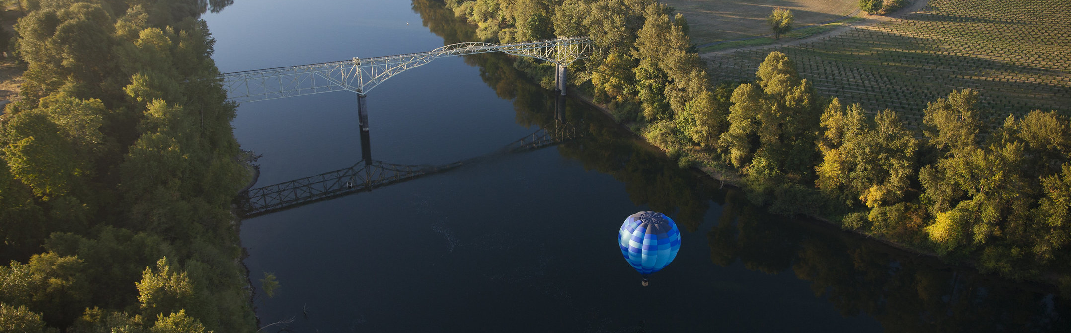
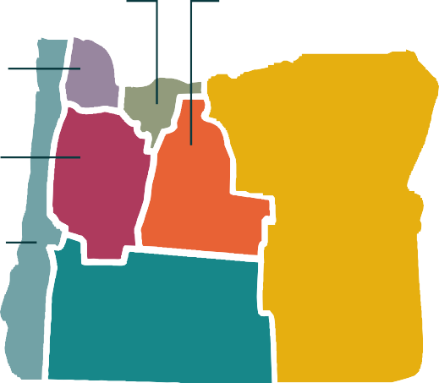
Tourism Drives Economic Growth
Across Oregon
(City/County Name)
TOURISM SPURS OREGON’S ECONOMY
In 2003, Oregon faced one of its highest unemployment rates in history. As part of a statewide initiative to create new job opportunities for Oregonians, the legislature made tourism and hospitality a pillar of Oregon’s economy by creating Travel Oregon and, with support from lodging operators, establishing a statewide lodging tax. This tax dedicated revenue into tourism development and market- ing for all of Oregon, and as the economy grew, 30% of the state lodging tax became focused on direct community investment via regional tourism organizations and grant programs.
This industry investment has delivered results. Over the past two decades, Oregon has seen consistent annual growth in jobs, visitor spending and related tax revenue that outpaces inflation. Travel spending across Oregon has more than doubled since 2003, and the tax revenue generated by that spending has nearly tripled. This economic activity has created more than 35,000 new jobs since 2003, providing meaningful opportunities in every corner of the state.
TOURISM CREATES CAREERS
Nationally, the travel and tourism industry provides more first jobs than any other industry, and the skills learned in these roles make a difference. Tourism jobs are also often small business jobs connected to the com- munities they serve across Oregon. The travel and tour- ism industry is the nation’s top small business employer, and 17% of early career tourism employees go on to own their own business. National studies have also shown visitation and exposure to destination marketing can improve impressions of communities as places to start and relocate businesses, meaning that tourism also serves a cycle of small business development in several unique ways.
Sources: US Travel Association, Oregon Employment Department
TOURISM STEWARDS OREGON’S FUTURE
As tourism organizations across the state bring increased focus to stewardship efforts, care is taken to align eco- nomic, social and environmental opportunities for today and well into the future:
In 2025, 40 Oregon communities worked together to achieve the nation’s first statewide “Destination Verified” status with trusted accessibility travel platform Wheel the World, ensuring disabled visitors and Oregonians alike can explore detailed listings and receive tailored recommendations based on their specific needs.
Tourism organizations bring marketing and outreach expertise through partnerships with other state and federal agencies, non-profits and businesses to address broad community challenges such as responsible recreation, wildfire safety or congestion management efforts at well-loved destinations.
The tourism industry strives to align tactics with broader state economic development efforts to ensure future prosperity in Oregon, whether that is aligning global sales and marketing work with international flight expansions at PDX or connecting local hospitality and agriculture leaders with renown journalists, recognizing Oregon as a world-class culinary destination.
5,880 jobs
$523M
10,730 jobs
$1.29B
34,860 jobs
$5.47B
23,140 jobs
$2.56B
26,520 jobs
$2.50B
12,880 jobs
$1.41B
$14.3 BILLION IN DIRECT TRAVEL SPENDING SUPPORTS 121,000 JOBS AND GENERATES $691 MILLION IN STATE AND LOCAL TAX REVENUE ACROSS OREGON
Source: Dean Runyan Associates Economic Impact of Travel Study 2024
7,010 jobs
$540M

Slide 2
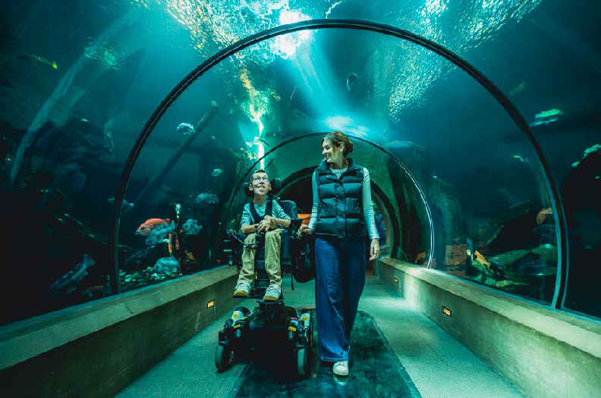
ECONOMIC IMPACT OF TOURISM IN (CITY/COUNTY) 2024
TOURISM DOLLARS AT WORK
IN (CITY/COUNTY)
Travel Oregon and its tourism partners invest millions of dollars in community initiatives through grant programs, strategic investment funds or direct sponsorship. In recent years, these investments have been critical contributors to local projects such as:
Supporting culinary tourism by investing in marketing and media efforts that highlight local food producers and restaurants, as well as providing the first $1million gift to the creation of the James Beard Public Market— establishing a new world-class destination downtown for or Oregonians and visitors from around the world to experience Oregon’s bounty.
Establishing and promoting the Oregon Outback, the world’s largest dark sky sanctuary, which capitalizes on emerging astro-tourism trends, brings new opportunities to a rural economy and protects habitat and species through travel along the pacific flyway.
Trail stewardship efforts, including responsible recreation education, maintaining some of Central Oregon’s well-loved trails and building new trails at popular destinations like Mt. Bachelor to support hiker and cyclist disbursement.
Supporting visitation all along the coast by funding the construction of a wheelchair accessible plaza area at the Oregon Coast Scenic Railroad’s Garibaldi Depot and several all-terrain track wheelchairs, available to locals and visitors free of charge.
Direct Travel Spending
$14.3 billion
Jobs
121,000
Employee Earnings
$4.67 billion
State & Local Tax Revenue*
$691 million
Overnight Stays
100 million
* State and local taxes include income taxes, gas taxes, rental car taxes and transient lodging taxes
Source: Dean Runyan Associates
Local Oregon tax receipts generated by tourists in 2024 accounted for $400 million in state revenue, and $291 million in local taxes—representing more than $406 per local household in the state.
For every $100 spent by visitors in the state, $33 goes directly back to locals in employee earnings.
TOURISM BOLSTERS COMMUNITIES
More than 120 cities and counties across Oregon collect a local transient lodging tax that is distinct from the statewide tax to expend on local programming. A state- wide study conducted by ECONorthwest in 2018 found that cities and counties that levied a local transient lodging tax spent the plurality of the revenue on general services. Other major categories of local investment include tourism facilities such as meeting spaces and sports fields; tourism promotion and marketing through organizations such as (local DMO) ; arts, culture and entertainment and local events.
In line with statute, 20% of state transient lodging taxes are directed to seven regional tourism organizations for community responsive tourism development and promotion. Local transient tax dollars, especially those expended on tourism facilities and promotion and marketing programs, can be leveraged against regional and state tourism expenditures to attract and steward visitors in individual communities. This increase in visitors, in turn, increases resources for arts and culture, infrastructure, and public services—directly benefiting Oregonians in those com- munities.
The Oregon Coast Aquarium in Newport was part of the Wheel The World “Destination Verified” assessment in Oregon.
We inspire travel that uplifts Oregon communities. Collaborating with stakeholders to align as stewards of Oregon, we work to optimize economic opportunity, advance equity and respect the ecosystems, cultures and places that make Oregon … Oregon.
Learn more at industry.traveloregon.com

