Slide 1
Authoring Accessible Documents
Digital Accessibility
Foundations
June 25, 2026
Hosted by Travel Oregon
Facilitated by Jen Macias De La Parra, Accessibility Consultant, CPACC

Slide 2

Accessibility check
Any digital materials I share in this presentation will include:
Added alt text to images
Checked headlines, outline, and reading order of slide layouts
Checked color contrast
Brief visual descriptions will be provided of informative images

Slide 3
Agenda
Welcome and Why This Matters
The Accessible Source File Mindset
Source File Structure: Microsoft Word + Acrobat Pro
Exporting Accessible PDFs
Alt Text in Practice
Accessibility Checklist
Q&A

Slide 4
What to expect
Real-world demos
using Microsoft Word and Acrobat Pro
Practical alt-text guidance
using industry materials
Guidance on when to handle it yourself
vs. when to flag it for the design team

Slide 5
Digital Accessibility
Overview
Digital Accessibility
Foundations
— Welcome!
— Why this matters

Slide 6
Digital Accessibility
Digital accessibility means authoring, designing and publishing digital content, tools, and technologies so that people of a range of abilities can perceive, understand, navigate, and interact with them — equally and independently.
This includes:
Websites and web apps
Mobile apps (iOS, Android)
Software apps/programs
Digital media (videos, audio, interactive content)
Electronic kiosks and digital displays, and more
Digital documents
(PDFs, Word docs, presentations)

Slide 7
Disabilities are a Sizeable Minority
1 in 4
adults in the U.S. lives with a disability
People with disabilities make up to 20% of the population size at any given time.
Notes:
Myth: A11y benefits only a small minority. This is false.
People with disabilities make up to 20% of the population at any given time.- Deque
Over 61 million U.S. adults, or 1 in 4, report having a disability - CDC
https://www.cdc.gov/disability-and-health/articles-documents/disabilities-health-care-access.html
Alt Text Example:
Open up the alt text panel to show the decision-making here.
“A horizontal row of four shapes: three purple circles and one red-orange diamond.”
Vs
“A horizontal sequence of four shapes: three purple circles and one red-orange diamond in the third position representing how 1 in 4 adults in the U.S. lives with a disability.”
A good rule of thumb for alt text is that it should describe what the image conveys, not add information the image doesn't contain on its own. If a viewer couldn't infer the "1 in 4" meaning from the graphic alone, that context might be better placed in the slide body text (which also benefits everyone, not just screen reader users).

Slide 8
Destination Stewardship
If the documents we produce aren’t accessible, we’re already closing the door before anyone arrives.
Notes:
Before we dive into the how of accessible documents, I want to take a moment on the why.
As a tourism commission, our job is to connect people to this state: its places, its experiences, its stories. But if the documents we produce aren't accessible, we're already closing the door before anyone arrives.
If our documents leave people out, our destination leaves people out.
The work we do is funded by taxpayers — all taxpayers. People with disabilities pay into this system just like everyone else, which means they have every right to access the information, resources, and opportunities we produce. Accessible documents aren't a courtesy. They're a commitment.
Today's training is about giving you the practical tools to honor that commitment — one document at a time.

Slide 9
Public-Facing Document Formats
Today’s webinar draws upon questions you answered upon registration. When it comes to public-facing document formats, PDFs lead by a significant percentage.
47%
share as PDF documents
18%
share as Word documents
12%
share as Google docs/sheets
8%
share Excel spreadsheets
3-5%
JPG/PNG, Website, Social Media, Canva, Tableau/Dashboards

Slide 10
Tools Used to Author Documents
Today’s webinar draws upon questions you answered upon registration. When it comes to authoring documents the most common tool used is Microsoft Word.
24%
author with Microsoft Word
18%
author with Google Doc/Sheets
17%
author with Adobe Acrobat
14%
author with Microsoft PowerPoint
11%
author with Canva

Slide 11
Training Goals
Integrate accessible authoring practices into your workflow
Develop a new export habit
Notes:
We're going to work toward two things today. First, developing a new checklist into your existing workflows, and
Second, a new export habit that makes accessible documents the default, not the exception.
No coding, no remediation software — just better authoring habits

Slide 12
The Accessible Source File
Mindset
Digital Accessibility
Foundations
— Goal: Shift the mental model
— Accessibility starts in the source file, not after the export

Slide 13
Ideal Use of Accessibility Features
Authoring Doc
Published PDF
Notes:
When accessibility is integrated directly at the authoring source level, most of the efforts required to making a document usable to people with disabilities can be built in automatically, by applying simple authoring best practices like using styles or other basic built-in software features.
The IDEAL flow would be that everything can be caught at the at the source level, but not all tools allow that to happen.
Documents created in Microsoft Word covers a lot and provides better accessibility potential if the proper authoring process is followed.

Slide 14
PDFs Inherit Accessible Elements
Authoring Doc
Published PDF
Notes:
On the flip side, if these tools are used poorly, the resulting PDF document may very well end up a complete accessibility failure.

Slide 15
Accessibility Features at the Source
Authoring Doc
Published PDF
Notes:
The reality is that it depends on the tools you use to author. It’s not that Google Docs is bad, it just means not all the accessible elements will translate into a PDF, requiring you to check it in Acrobat Pro.
One of the reasons why it is so important to integrate accessibility prior to the conversion process is to have a chance to integrate as much structure and semantics as possible inside the document. As with accessible webpages, accessible PDF documents use tags to indicate the structural elements of the document’s content (chapters, headings, text, multi-column text, graphics, paragraphs, tables, footnotes, etc.) and how these elements relate to each other.
Building it into the source document rather than bolting it onto the PDF document.

Slide 16
Accessibility Starts in the Source File
Many of your documents begin as a Word Doc, Google Doc, or PowerPoint file before being converted into PDF.
Integrating accessibility early in the authoring process makes that conversion smoother.
Building accessibility in from the start eliminates the need for remediation altogether.
Consider the experience:
“Untagged PDF documents are very annoying and difficult to use for people who cannot see and need to use screen readers in order to discover their content.”
- Denis Boudreau, Deque
Notes:
The most efficient way to build in accessibility and to ensure properly tagged content in a PDF document is making sure the proper semantics are brought into the document prior to its conversion to PDF.
Untagged PDF documents are very annoying and difficult to use for people who cannot see and need to use screen readers in order to discover their content.

Slide 17
Accessible authoring from the start means no remediation, no rework—just documents that work for everyone.

Slide 18



Support all the ways people consume digital information
Visual
All images presented on screens, videos, text, websites, captions
Audio
Music, speech, notification chimes
Haptics
Physical reminders of notifications or interactions

Slide 19
What Makes and Breaks
Document Accessibility?

Slide 20
What Breaks Document Accessibility?
Missing or incomplete document titles
Missing or incomplete alt text for images
Absent or inconsistent content structure
No language indicators
Non-intuitive navigation patterns
Notes:
Missing or poor document titles – The title is the first information that is conveyed to screen reader users when opening a PDF document. This information is important for them to validate which document they’re currently viewing.
Missing or poor alternate text for image - sGraphical elements like pictures, icons, illustrations, charts, and the like convey information that only exists in a graphical format. When informative images are not described in text, this content is lost to screen reader users. On the other hand, decorative images need to be ignored by screen readers, in order to reduce noise.
Missing or poor content structure – The general structure of a document, including such components as paragraphs, lists, and headings, is normally represented visually, thus helping users understand how a document is organized. Screen reader users, being unable to see the visual formatting of a document, cannot rely on this information to understand its organization. Users need that visual organization conveyed semantically, using PDF tags.
4. Missing or poor language indicators – Screen readers cannot guess which language the content of a PDF is in.
Missing or poor navigation patterns – Users will normally rely on their sight to quickly navigate in a document, isolate the section they’re interested in and jump directly to it. Without the ability to see the pages and using a screen reader, it is not possible to jump directly to a precise position on the page, without having listened to all the preceding content. In order to make it easier for users to navigate through a document, navigation pattern

Slide 21
What Makes Document Accessibility?
Descriptive, meaningful document titles
Clear, informative alt text for meaningful images
Well-defined content structure with headings
Accurate language indicators
Consistent, intuitive navigation patterns

Slide 22
Microsoft
Word
Digital Accessibility
Foundations
— Goal: Build practical Word habits that carry through to final PDFs

Slide 23
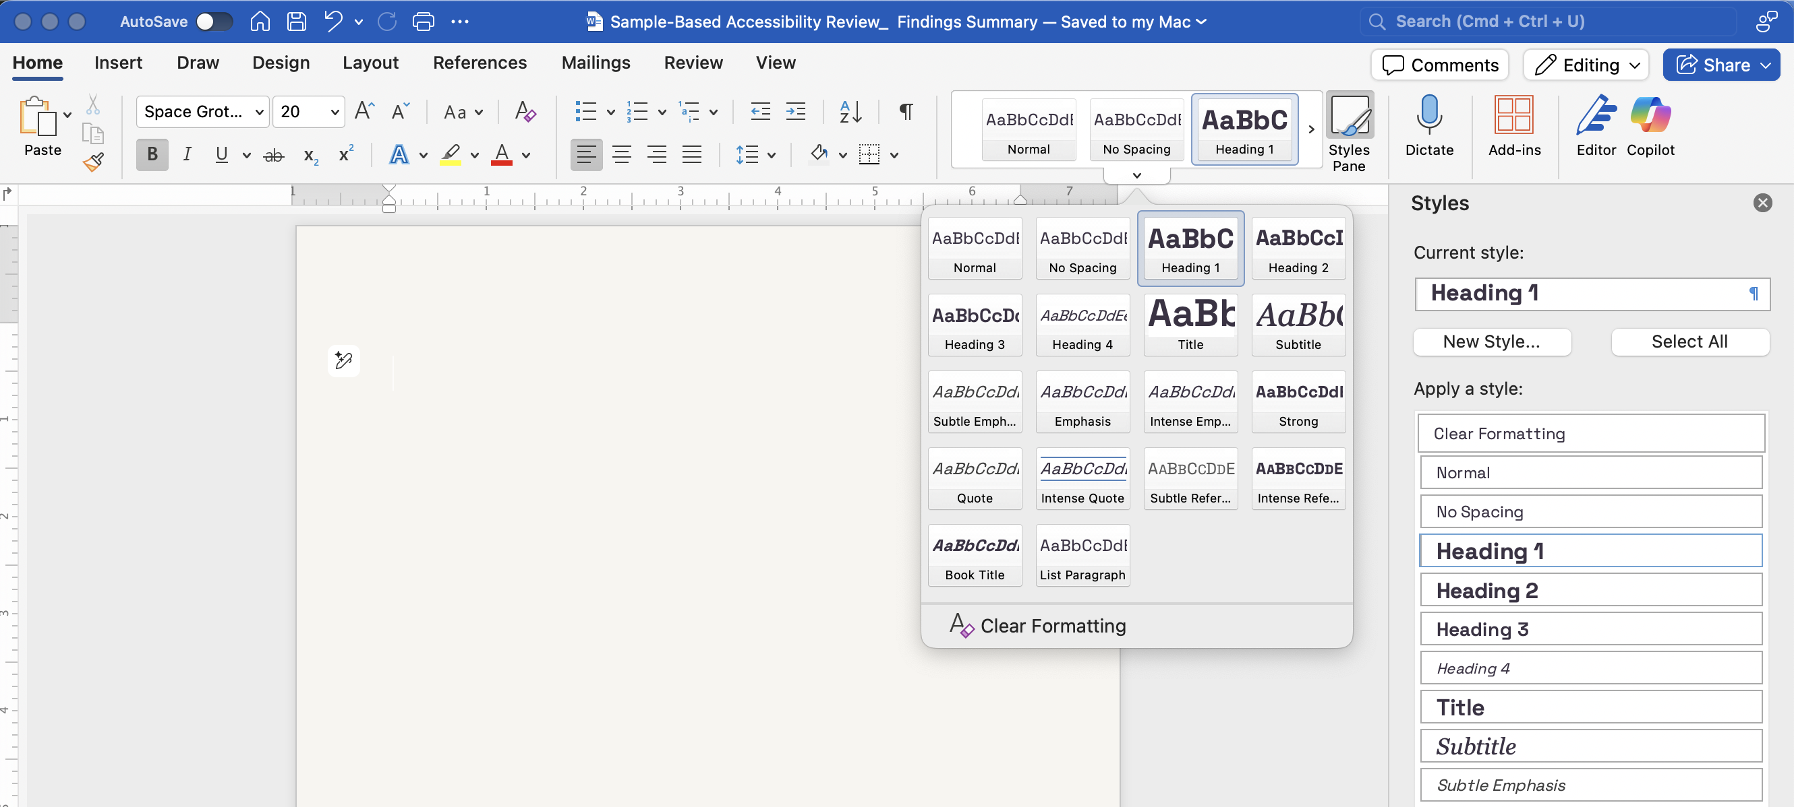
Heading Styles
Notes:
Heading Styles (8 min)
Show the Styles panel — demonstrate applying H1, H2, H3 instead of bold + font size
Why it matters: screen readers use heading structure to navigate documents
DEMO: Open a sample doc — show broken structure vs. correct heading hierarchy
Common mistake: using bold text to fake a heading
Headings act as an outline or interactive table of content for a document in the sense that they enable assistive technology users to jump from one part of the content to another, as long as these headings are tagged properly. It is therefore crucial to make sure headings are semantically defined in the authoring tool using styles rather than simply changing their visual presentation with varying font sizes, font faces, and colors to make them look like headings.
Accessible documents use headings to convey the logical structure of their content. Using headings hierarchically and avoiding skip levels helps users of assistive technologies make sense of the content structure. Such users can then rely on a logically organized outline to jump directly to the content they want to read.
It is most efficient to identify headings in the authoring software rather than in Acrobat Pro, because styles applied in this way will then systematically be applied to all other text strings marked as headings, increasing general consistency in presentation and layout. Headings can always be added or fixed in Acrobat Pro after conversion but, again, will prove much more time consuming if only handled once the conversion process is completed.

Slide 24
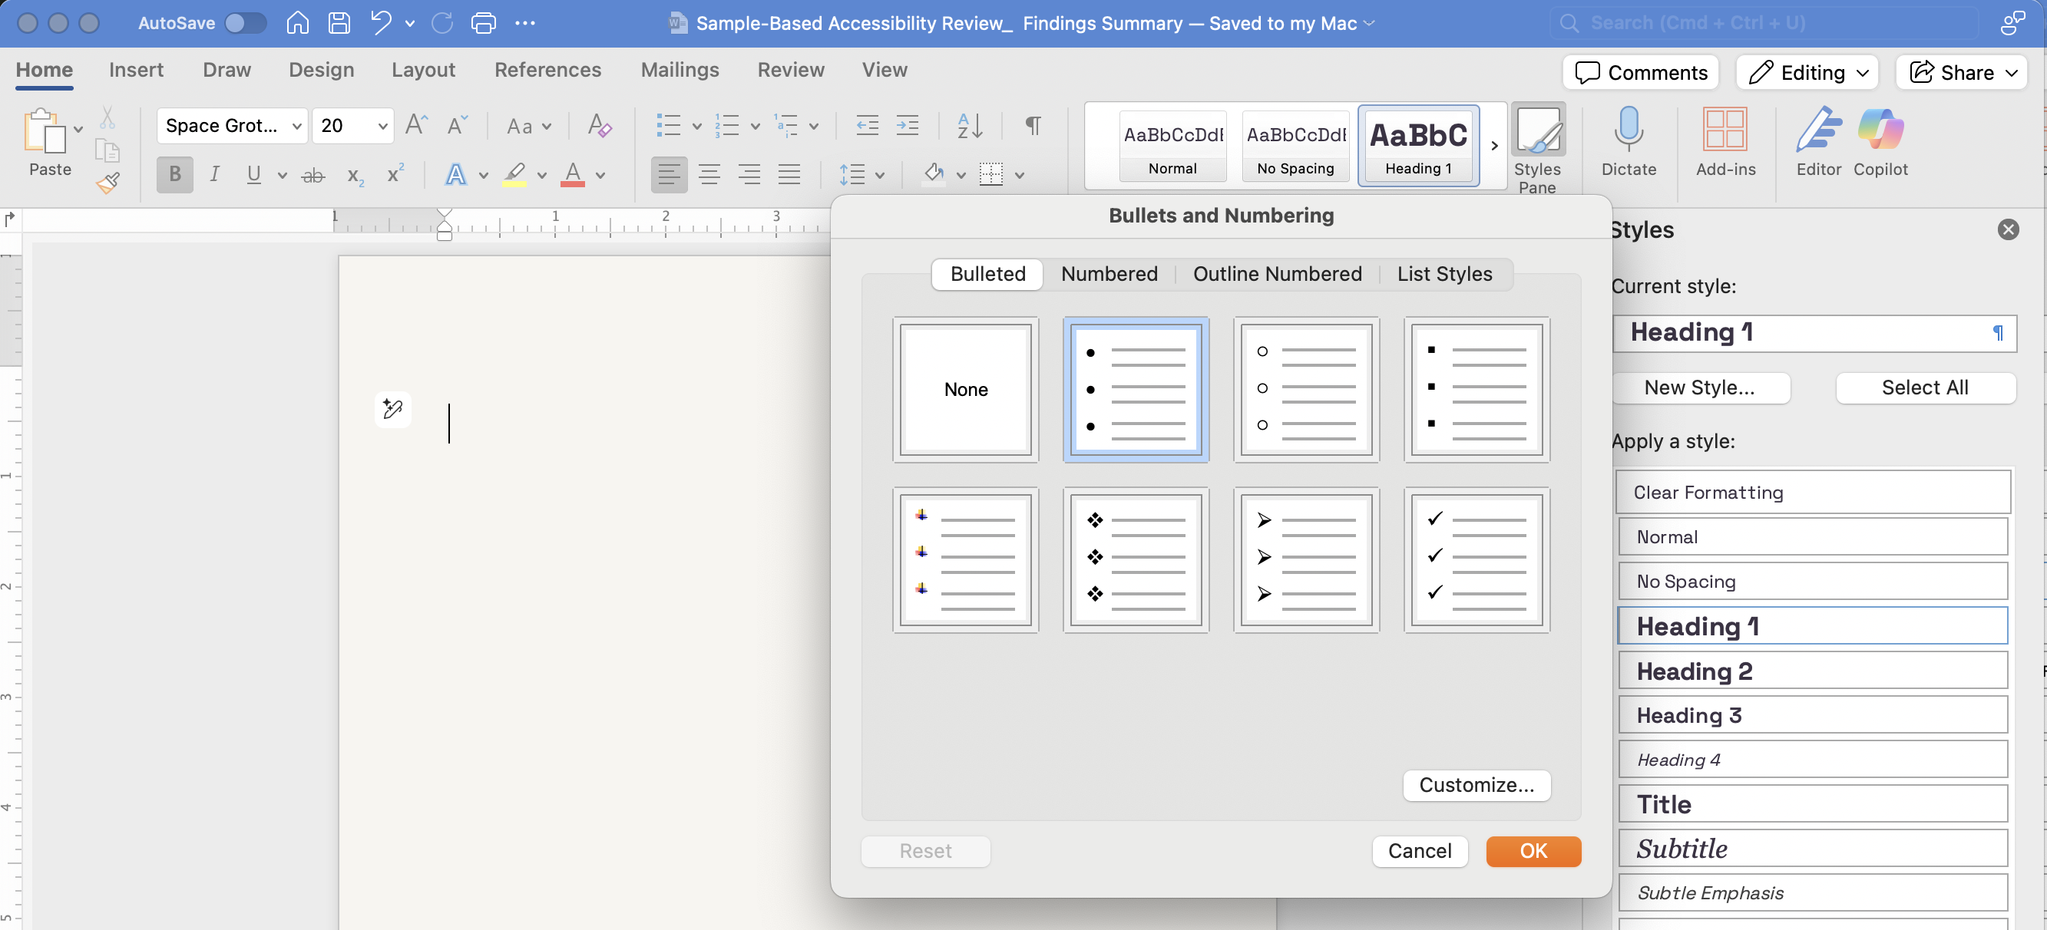
Lists
Notes:
Lists (3 min)
Always use Word's built-in list styles — never manually type bullets or dashes
DEMO: Show Insert > List vs. manual bullet character
Lists of items should be properly formatted in the authoring tool with list tags, so assistive technologies can express the relationship between list items and allow users to navigate from one list to another, or from list item to list item. Simply using line breaks to separate list items is not adequate, as structure (or lack thereof) does not programmatically translate to assistive technologies.
The easiest way to create lists is to format them properly using list markup and styles in the authoring tool before conversion (ordered or unordered). Acrobat Pro can be used to tag lists after conversion as well, but only regular unordered lists are available in PDF (it is impossible to semantically tag ordered lists in PDF). Once converted to PDF, ordered lists will simply be considered as unordered lists. To turn an unordered list back into an ordered list, authors will need to manually add a number in front of each list item, as part of the list item.

Slide 25
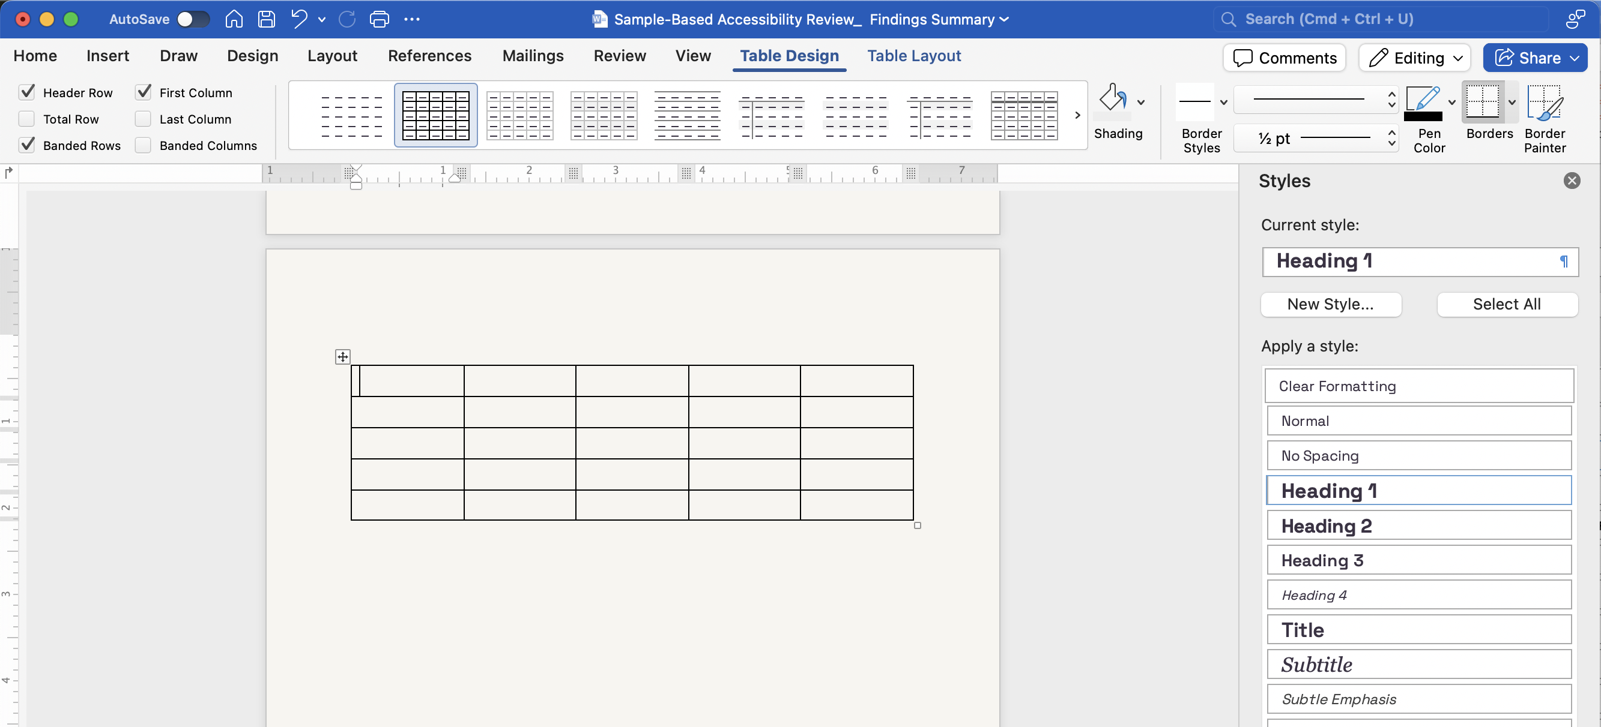
Tables
Notes:
Tables (5 min)
Every table must have a defined header row (Table Design > Header Row checkbox)
Avoid merged cells and nested tables when possible
Tables are for data — not for layout or visual alignment
DEMO: Show how to define a header row in an existing table

Slide 26
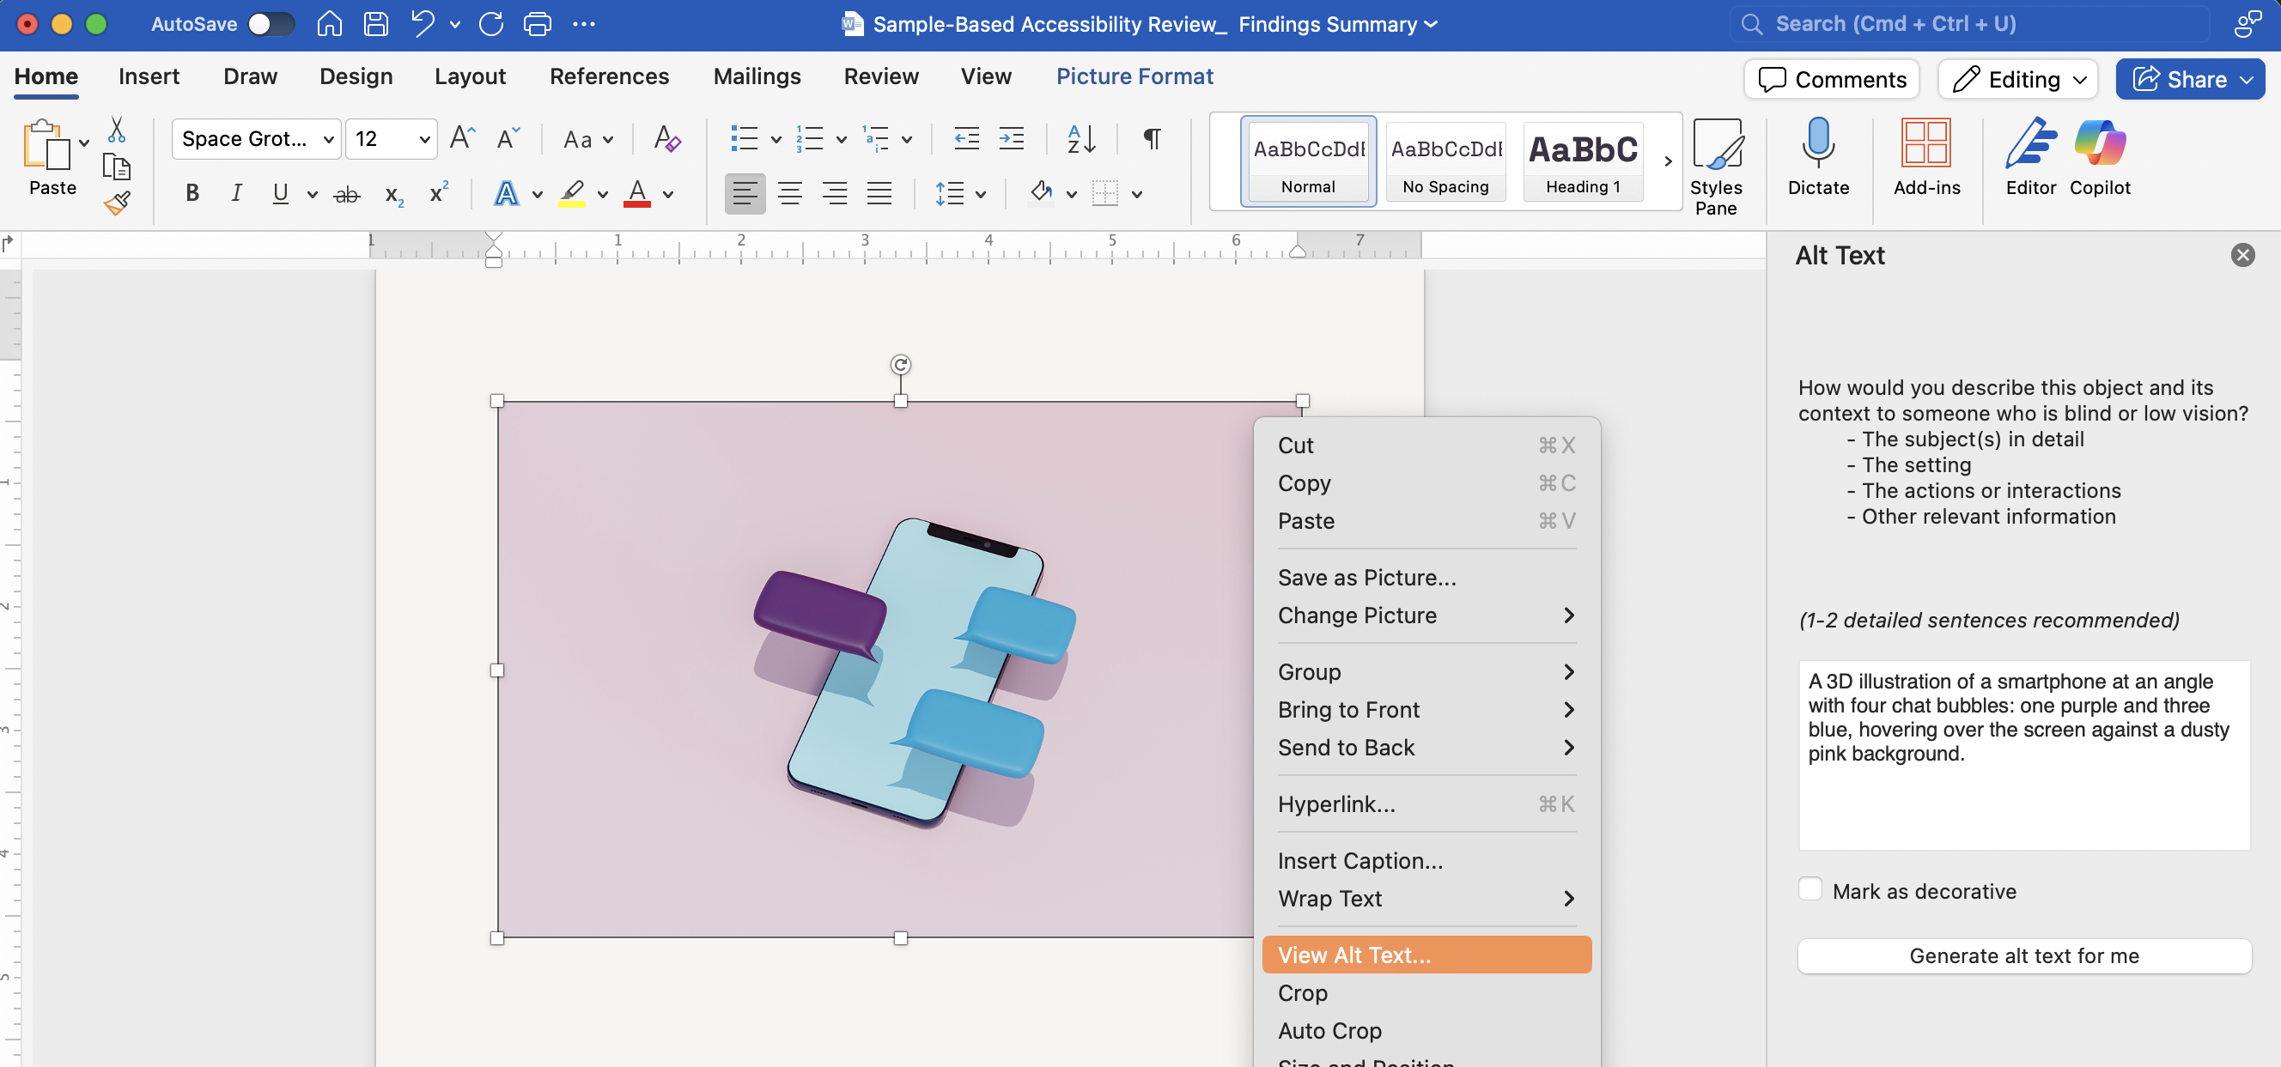
Alt Text
Notes:
Alt Text for Images & Charts (5 min)
Right-click image > Edit Alt Text — show the panel
Write descriptions that convey meaning, not just appearance
Mark decorative images as decorative (check the box)
DEMO: Use a chart from Travel Oregon's Economic Impact Report as a live example

Slide 27
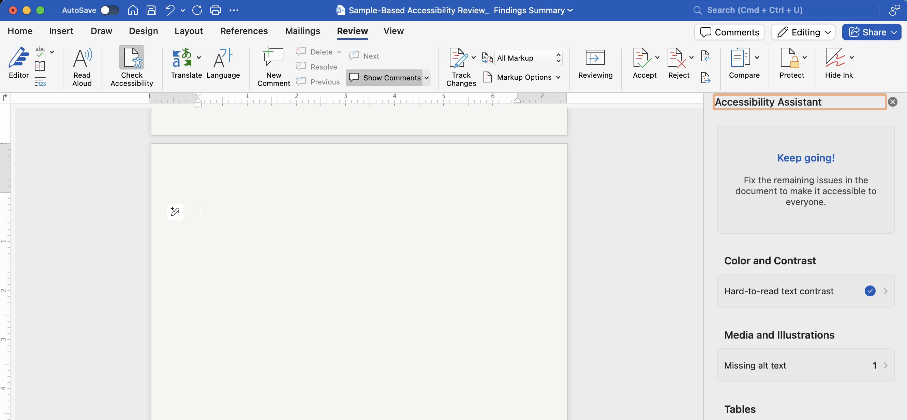
Accessibility Checker
Notes:
Accessibility Checker (4 min)
Review > Check Accessibility — walk through the panel
Show how to interpret and fix a common error (missing alt text, no heading structure)
Encourage teams to run this before sending files to the design team

Slide 28
Questions
& Answers
Digital Accessibility
Foundations

Slide 29
Exporting Accessible
PDFs
Digital Accessibility
Foundations
— Goal: Establish a new export you can immediately use
Notes:
5 mins

Slide 30
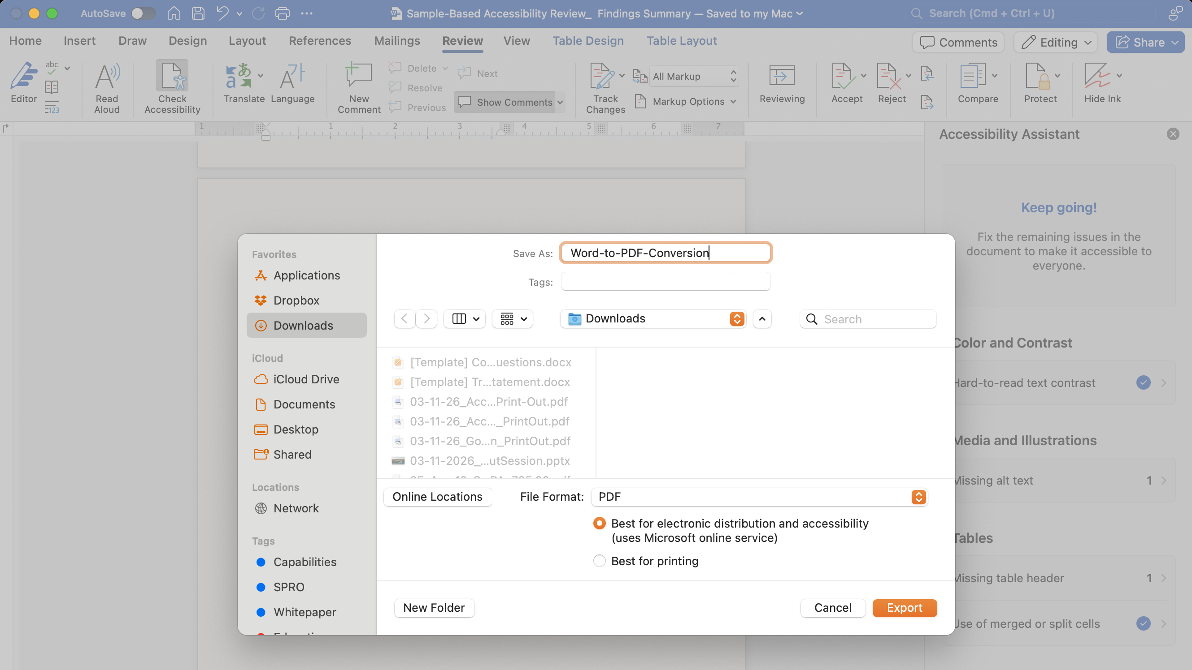
Export vs. Print to PDF
30
Notes:
Print to PDF = a flat image — no tags, no structure, not accessible
File > Export (or Save As PDF with settings) = structured, tagged PDF
DEMO: Show both methods side-by-side — the Export dialog with "Document structure tags" checked
This single habit change applies to every file every person in this room creates
Correct Export Settings — Word (4 min)
File > Save As > PDF > Options button
Check: "Document structure tags for accessibility"
Check: "Document properties"
DEMO: Export a sample Word doc using correct settings
Correct Export Settings — PowerPoint (3 min)
File > Export > Create PDF/XPS > Options
Check: "Document structure tags for accessibility"
Check: "Document properties" and "Convert slide titles to bookmarks"

Slide 31
Hyperlinks
Write descriptive link text.
Descriptive link text helps screen reader users and people with cognitive disabilities differentiate between links.
Avoid:
“link to…”
“click here”
“read more”
Notes:
Hyperlinks (1 min)
A link MUST have programmatically determinable text.
The purpose of each link SHOULD be able to be determined from the link text alone.
The link text SHOULD NOT repeat the word "link."
The full hyperlink SHOULD be included in the document.
More:
links added in the PDF document with not be visually indicated; this might create discoverability issues for sighted users. Therefore, adding links in the document source rather than waiting until after the conversion process is completed is always preferable.
Poor link text such as “click here” or “read more” is often an issue for users who can’t see the context of the page. Sometimes, in order to make sure the links’ purpose remains clear out of its context, it is necessary to compensate with complementary information beyond the visible link text. While this would normally be achieved using aria-label or off-screen CSS positioning in a regular HTML file, doing this in a PDF document requires hiding the supplemental information behind the links. This can only be achieved using the alt text property in Acrobat Pro – one of the rare cases where part of the mark up needs to be handled after the conversion process.

Slide 32
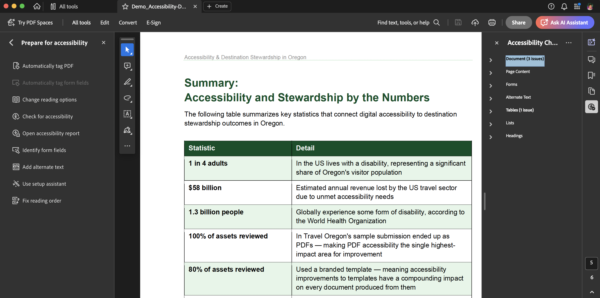
Quick Check in Acrobat Pro
Notes:
Quick Check in Adobe Acrobat (3 min)
All Tools > Accessibility > Accessibility Check — show where it lives
In some cases, staff don't need to fix every error — they need to recognize when to flag for the design team

Slide 33
Questions
& Answers
Digital Accessibility
Foundations

Slide 34
Alt Text
In Practice
Digital Accessibility
Foundations
— Goal: Understand how to approach alt text
Notes:
Goal: Make alt text writing feel concrete and doable using Travel Oregon's own documents.

Slide 35
What is Alt Text?
Alt text is a concise, informative description of visual content that makes images accessible to more people, including screen reader users, people with cognitive disabilities, and people with limited internet bandwidth.
Resource:
How to write an image description by Alex Chen
Alt Text
= Short Text Alternative
Use for: Simple, informative images
Length: Brief (typically 150 characters or less)
Purpose: Conveys the same information and serves the same purpose as the image
Examples: A photo of a person, a simple icon, a product image

Slide 36
What is an Image Description?
A written caption that describes the essential information in an image.
Image descriptions can be applied to any visual content—photos, graphics, gifs, and video.
Resource:
How to write an image description by Alex Chen
Image Description
= Extended/Longer Description
Use for: Complex images that
can’t be fully described briefly
Length: As long as needed to reasonably convey information
Purpose/Examples: Provides detailed info for images like charts, graphs, infographics, diagrams, and data visualizations

Slide 37
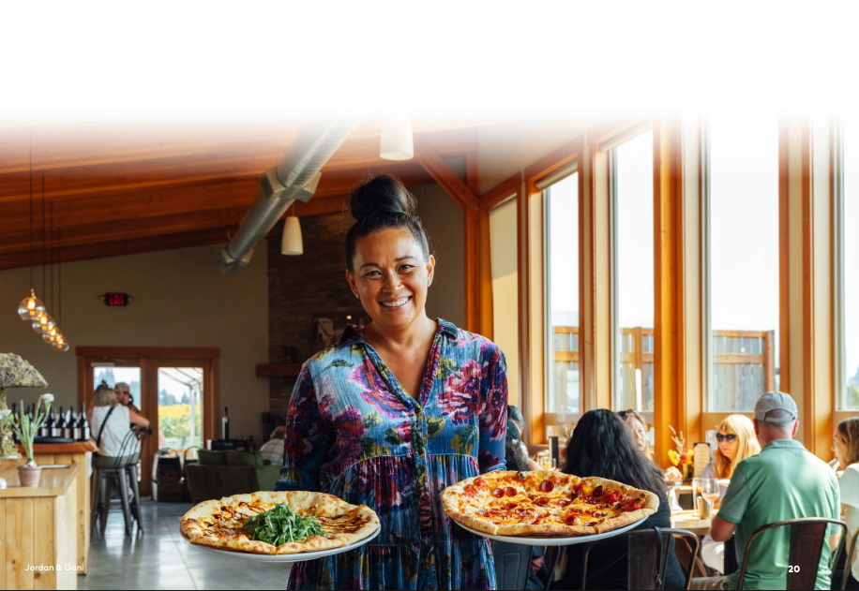
Demo: Photo
Notes:
An important question to ask ourselves is, “what is the purpose of this photo?”

Slide 38
Alt Text Example for a Photo
Alt Text
“A smiling woman in a floral dress holds two pizzas; a white pizza topped with arugula and a pepperoni pizza, in a warm, sun-filled restaurant with wood-beam ceilings and diners in the background.”
Object: A woman in a floral dress holding two pizzas in a bright, wood-beamed restaurant dining room.
Action: Smiling while serving a white pizza topped with arugula and a pepperoni pizza.
Context: The warm, sun-filled busy restaurant with diners in the background, with a wine display visible near the entrance.

Slide 39
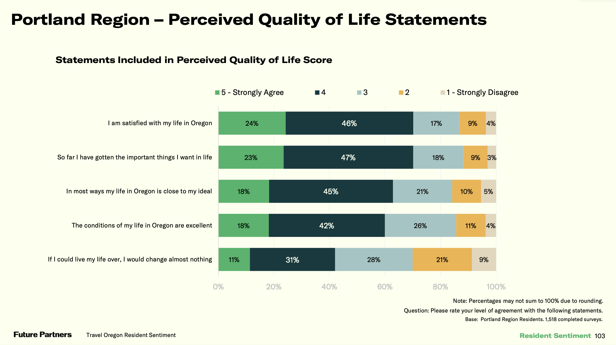
Demo: Data Rich Images

Slide 40
Image Description for Data Rich Image
Image Description
Object: A horizontal stacked bar chart titled "Portland Region – Perceived Quality of Life Statements
Action: Displaying Portland region residents' level of agreement with five quality of life statements, rated on a scale of 1 (Strongly Disagree) to 5 (Strongly Agree)
Context: Across all five statements, the majority of respondents agreed or strongly agreed. Satisfaction with life in Oregon and achieving important life goals scored highest, with roughly 70% of respondents rating both a 4 or 5. Residents were least likely to agree that they would change nothing if they could live their life over, with only 42% rating that statement a 4 or 5.
Notes:
All combined:
A horizontal stacked bar chart showing Portland region residents' agreement with five quality of life statements on a scale of 1 to 5. Satisfaction with life in Oregon and achieving important life goals scored highest, with approximately 70% of respondents agreeing or strongly agreeing. Residents expressed the least certainty about living their life over unchanged, where only 42% agreed or strongly agreed. Data is based on 1,518 completed surveys of Portland region residents.

Slide 41
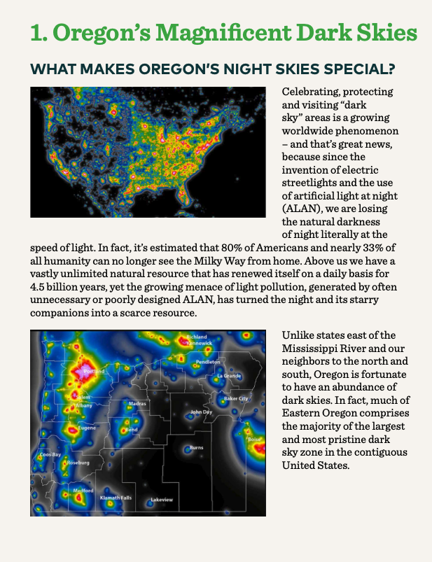
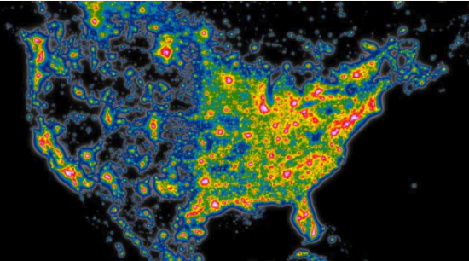
Demo: Maps

Slide 42
Alt Text Example for a Map
Alt Text
"A heat map of North America showing light pollution levels, with colors ranging from black and blue in low-pollution areas to yellow, orange, and red in high-density urban centers. The eastern United States shows the highest concentration of light pollution."
Object: A heat map of North America
Action: Displaying light pollution levels using a color gradient
Context: Colors range from black and blue in rural, low-pollution areas to yellow, orange, and red in high-density urban centers, with the eastern United States showing the highest concentration of light pollution
Notes:
Data visualizations require descriptive alt text that conveys the meaning and key takeaway, not just the appearance
The "so what" matters — good alt text communicates what a sighted user would walk away understanding from the image
Complex images may need extended descriptions — if this map were in a Travel Oregon document with specific data points, a longer description or caption might be warranted in addition to the alt text

Slide 43
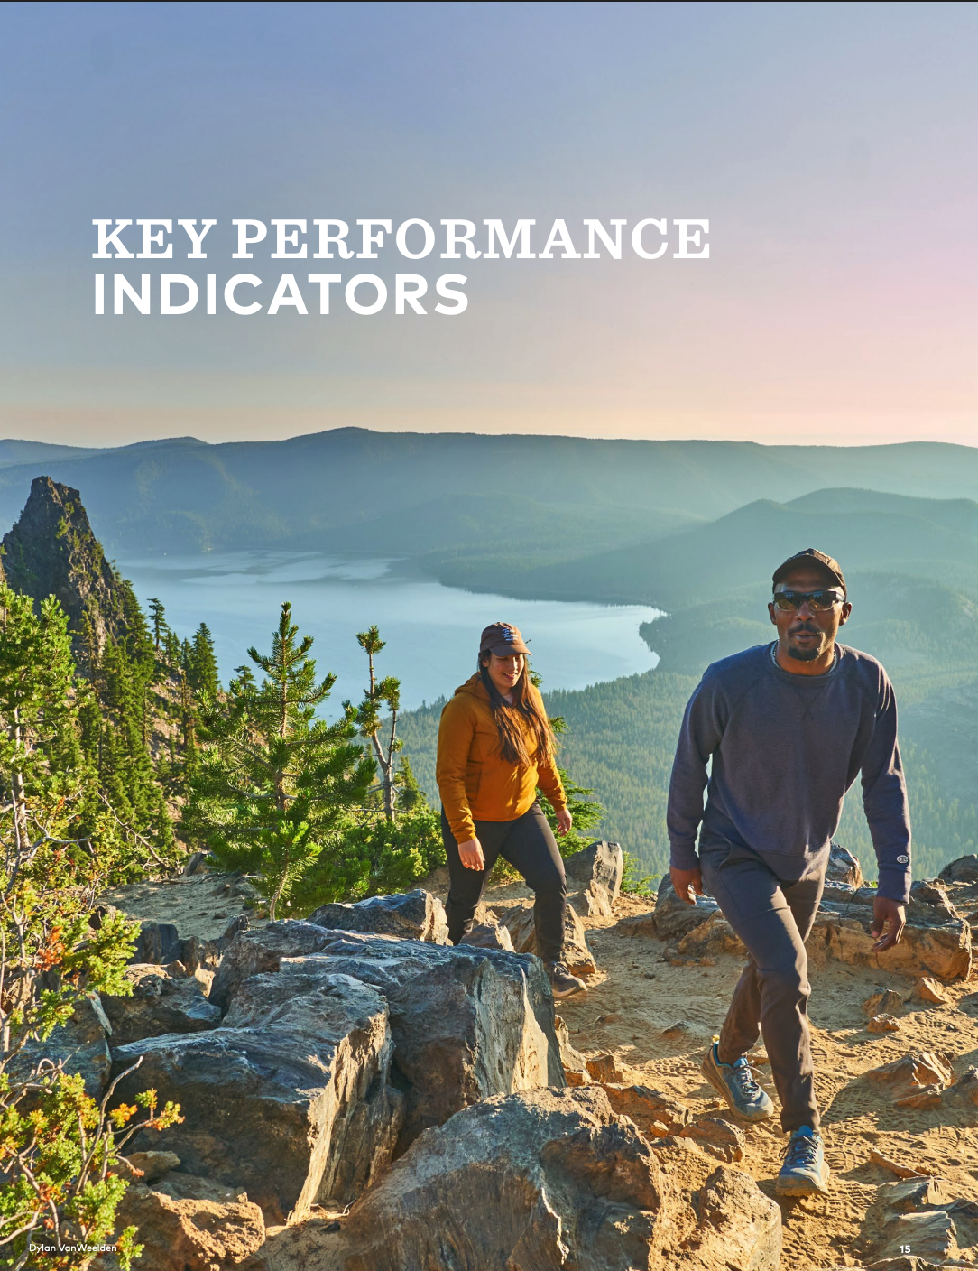

Demo: Decorative Images
Notes:
This is a strong decorative image candidate. In a Travel Oregon document, a scenic landscape like this is often used to set mood and tone rather than convey specific information. If that's the case, marking it as decorative is appropriate — and frees the author from needing to craft descriptive alt text.
The image's purpose in the document determines whether alt text is needed, not the image itself.

Slide 44
Accessibility
Checklists
Digital Accessibility
Foundations
— Checklist
— New export habits

Slide 45
Checklists
Microsoft Word Accessibility Checklist by Deque
PowerPoint Accessibility Checklist by GSA
PDF Accessibility Checklist by University of Illinois

Slide 46
Five Export New Habits: Word Documents
  Use heading styles
  Write alt text for meaningful images
  Write descriptive links for text
  Define header rows in tables
  Export to PDF: never Print to PDF

Slide 47
Five Export New Habits: PowerPoint
  Use style layouts
  Check reading order
  Define header rows in tables
  Write descriptive links for text
  Write alt text for meaningful images

Slide 48
Resources
Getting Started
Alt Text
→ Tips for Getting Started
→ Authoring Meaningful Alt Text
→ Accessibility for Teams
→ How to Write an Image Description
→ The difference between Alt Text and Image
Descriptions
Accessible PDFs
→ Requirements for an Accessible PDF
Understanding WCAG
→ Accessible PDFs: Common Barriers
→ W3C
→ Accessible PDFs: Authoring Best Practices
→ Level A, AA, and AAA
→ Accessible PDFs: Proper Conversion Process
→ Acrobat Accessibility Tutorials
→ Understanding 2.0, 2.1, 2.2
→ Create Accessible PDFs in Microsoft Word
→ POUR Principles
→ How to Meet WCAG (Quick Reference)
48

Slide 49
Questions
& Answers
Digital Accessibility
Foundations

Slide 50

Ask an Expert sponsored by Travel Oregon
Digital Accessibility Consultation
Get free, personalized guidance to make your destination’s digital experiences more welcoming for travelers.
What you get:
One-on-one consultation with an accessibility specialist
Tailored strategies for your websites, apps, social media, and booking systems
Follow-up summaries with resources and next steps
Jen Macias De La Parra
Experience Designer & Accessibility Consultant
Book consult through
Ask an Expert program ↗

Slide 51

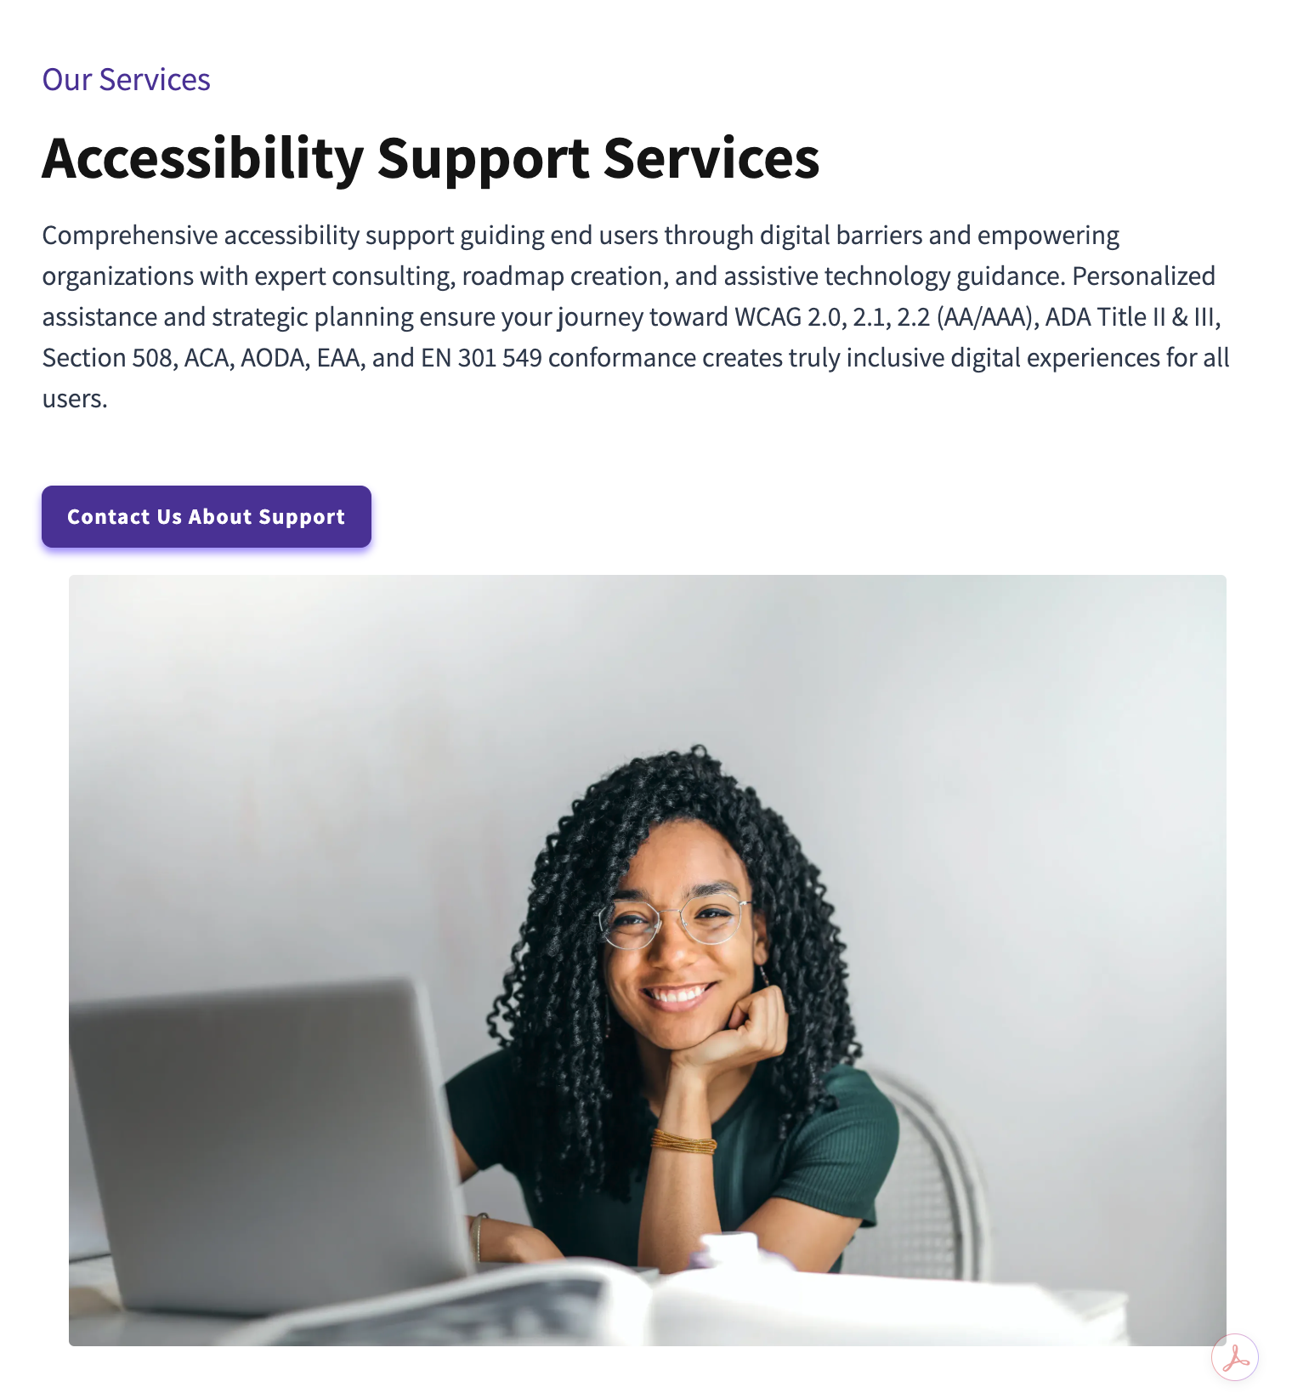
Digital Tourism Accessibility Snapshot
Complimentary Offer
From Zenyth Group
What’s included:
High-level digital accessibility risk summary
Booking engine and map accessibility check
Public-facing accessibility messaging review
Governance gap observations
3 prioritized action steps
Schedule a call with Daryn Harpaz to get started ↗

Slide 52
Thank you!
Jen Macias De La Parra
Experience Designer, Accessibility Consultant
e / hola@jenmacias.com
s / www.linkedin.com/in/jen-macias
w / consultant profile

